Slide 1
Is this a cool font?
These are it’s default settings.

Slide 2
New links
https://www.google.com/search?q=pigeon+pixel+gif&safe=active&source=lnms&tbm=isch&sa=X&ved=2ahUKEwjjhaKrgrbwAhWszIUKHZJtCgoQ_AUoAXoECAEQAw&biw=1920&bih=969#imgrc=8XLAKUxOb9cTwM
https://onlinepngtools.com/pixelate-png
https://giventofly.github.io/pixelit/#tryit !!!! 👌
https://pixel-me.tokyo/en/
https://pinetools.com/pixelate-effect-image (calc. final img size and maybe use this)
Just use the resize feature in any graphics editor

Slide 3
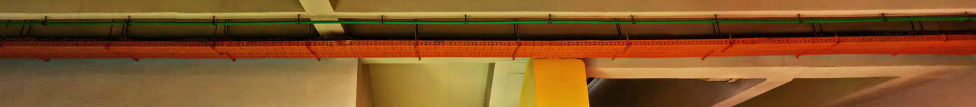
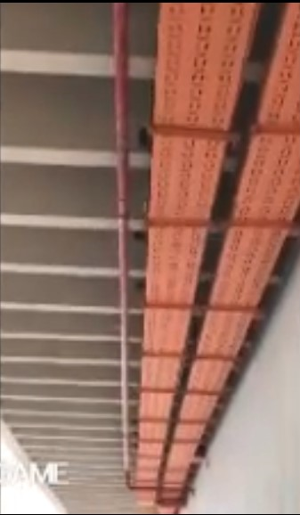

Slide 4
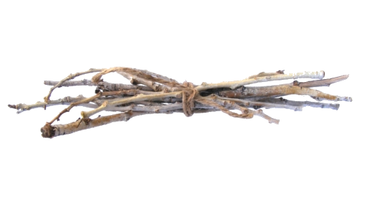

Slide 5
